Slide 1

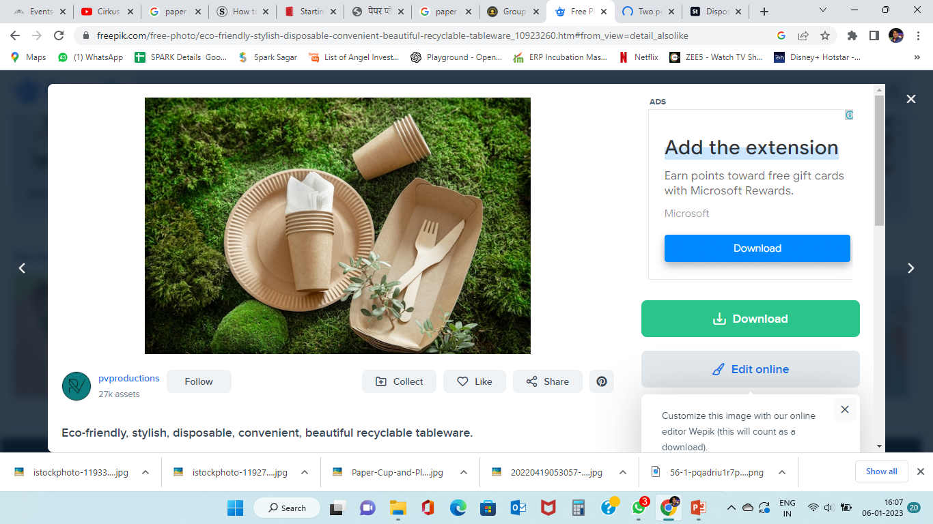
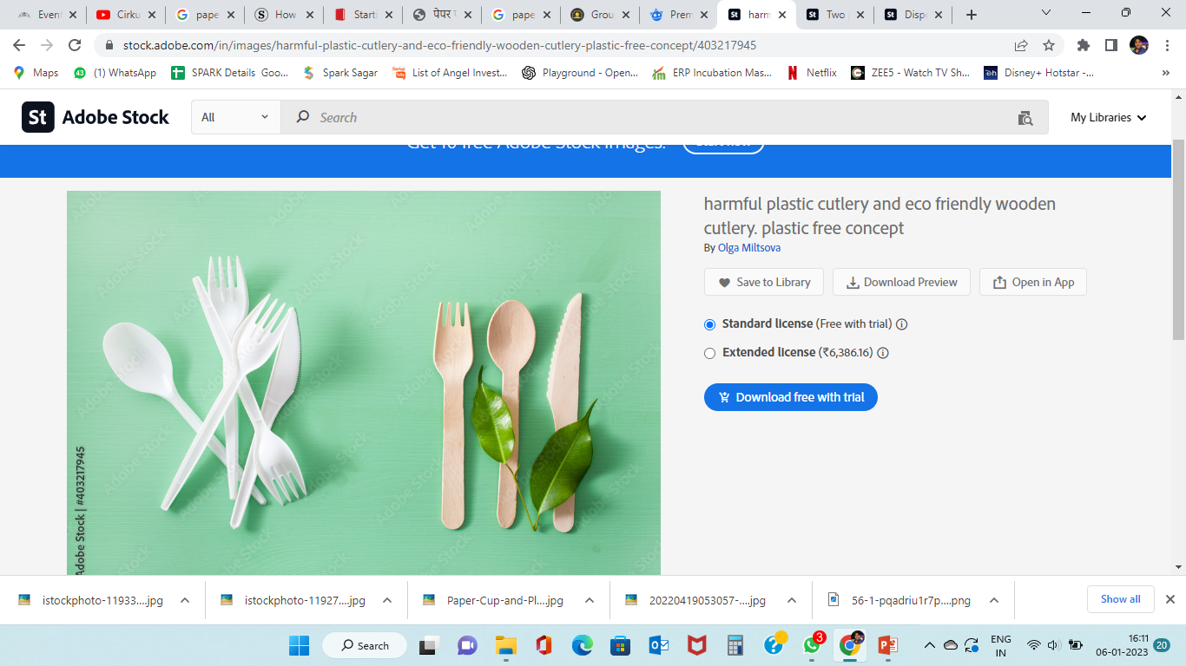
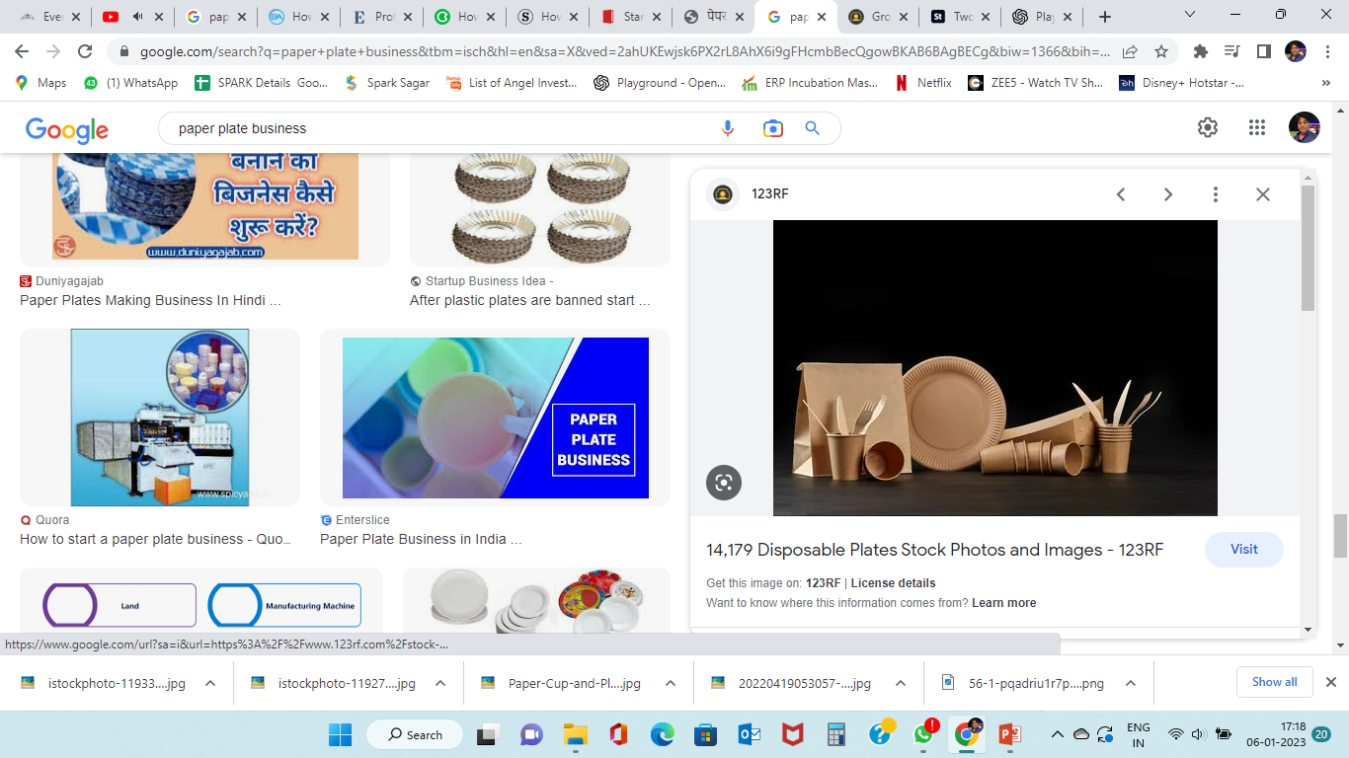
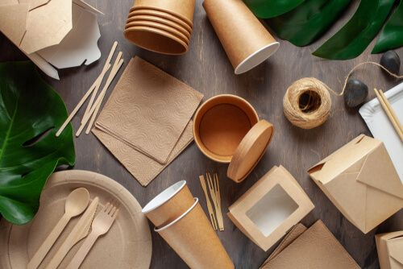
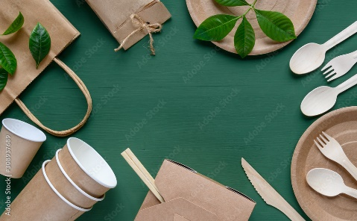
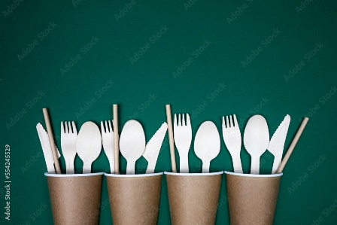
KAVYA ENTERPRISES
Startup Name
For Nature…with Nature
Founder – Shovit Kumar

Slide 2

About us -
Welcome to Paper Cutlery! We are a Startup that specializes in providing eco-friendly and stylish disposable paper cutlery for businesses and events. With more than 2 years of experience in the industry, we are committed to delivering top-notch products and services. At Paper Cutlery, we understand the need for convenience and sustainability. That’s why our paper cutlery is designed to be both stylish and durable, with a range of designs to match any occasion. We also use eco-friendly materials whenever possible, making sure that our products don’t harm the environment. We’re proud of our customer service and the high-quality products we offer. We want to make sure that our clients are always satisfied with our service, so we strive to provide the best possible experience for them. Our team is dedicated to providing excellent customer service and ensuring that your orders are delivered on time and in perfect condition. We’re excited to have you with us, and we look forward to helping you find the perfect paper cutlery for your next event or business occasion. Thank you for choosing Paper Cutlery!
Vision -
Our vision for the Paper Cutlery Business is to become the leading manufacturer of eco-friendly paper cutlery for the food service industry. We strive to create products that are both cost-effective and environmentally friendly to ensure sustainable practices in the future. By utilizing innovative technologies and materials, we aim to provide superior quality and affordability to our customers.
Mission-
Our mission is to provide an accessible, reliable, and affordable solution for food service businesses to reduce their environmental impact.

Slide 3
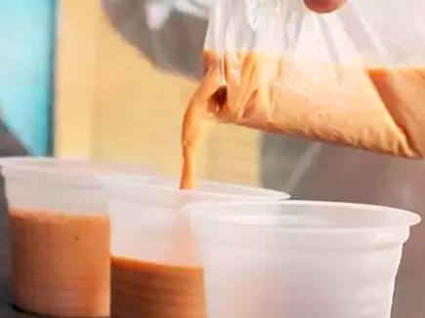
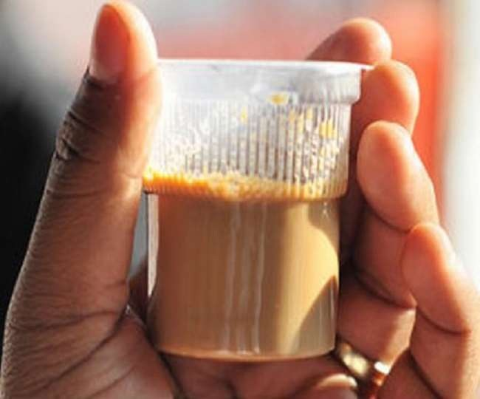
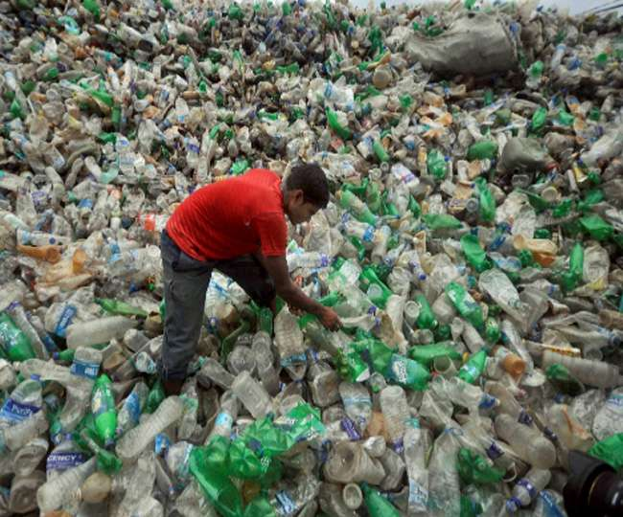
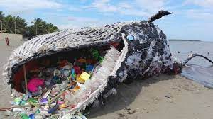
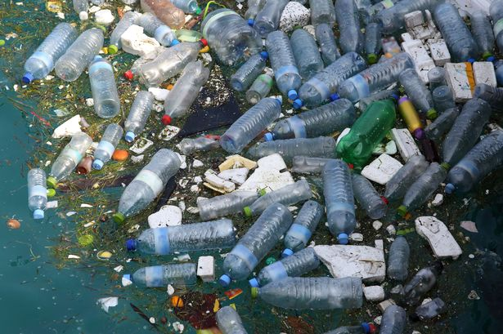
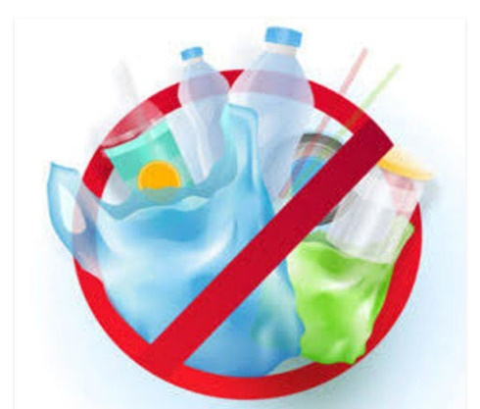
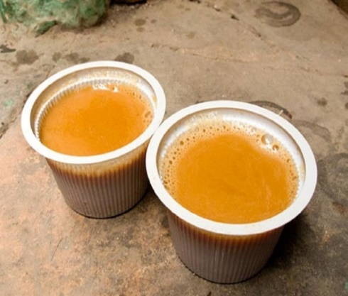
Disadvantages & Problem with Plastic disposable
Plastic disposable products are non-biodegradable, meaning they will not decompose and can remain in the environment for hundreds of years. This can cause harm to the environment and wildlife.
Plastic disposable products are made from non-renewable resources such as petroleum and natural gas, which are finite resources. This means that the production of plastic disposable products contributes to global warming.
Plastic disposable products are often made from low-grade plastics which contain toxic chemicals that can leach into the air and water. This can lead to negative health effects for humans and animals.
Plastic disposable products often require extra packaging, which can contribute to landfills and pollution.
Plastic disposable products are often cheaper than reusable products, but this can lead to people disposing of them more often, which can create more waste.

Slide 4


Slide 5
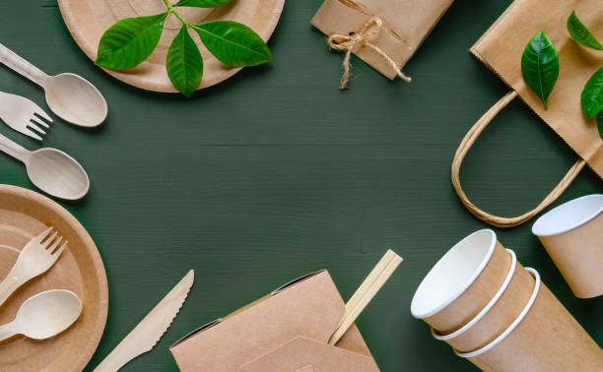

Paper Cutlery
&
Leaf Dona Pattal

Slide 6
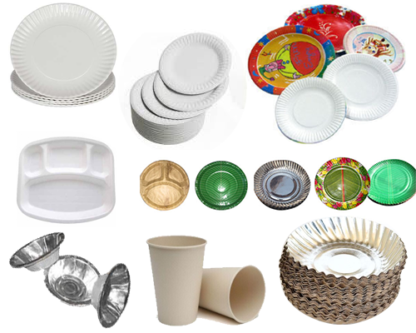
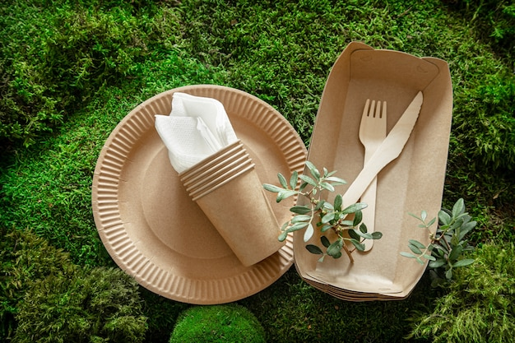
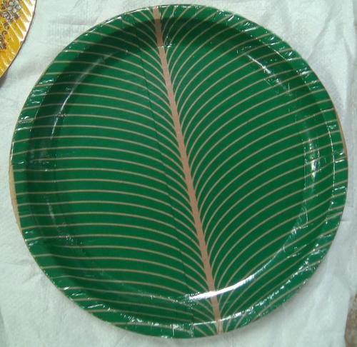
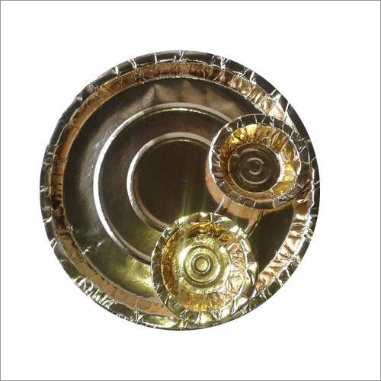
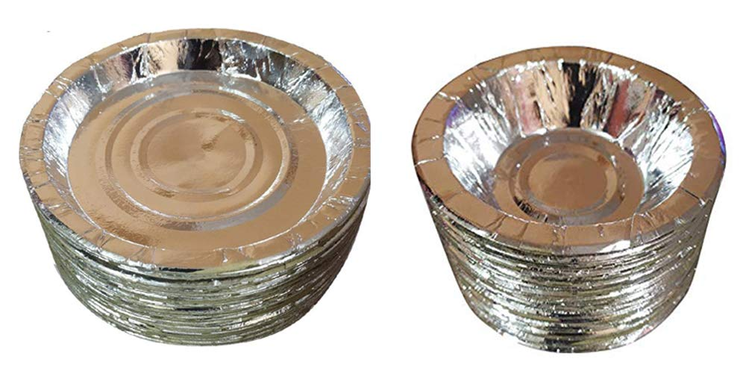
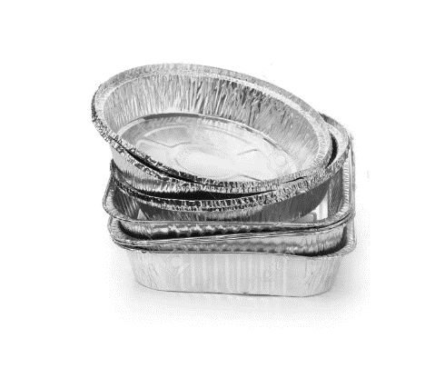
Advantages of Paper Disposal
1. Cost-effective: Paper disposables are a cost-effective option for businesses. They are generally inexpensive and can provide a great value for the money.
2. Convenient: Paper disposables are easy to use and provide a quick and easy way to dispose of items. They can be easily thrown away after use and require minimal effort to clean up.
3. Environmentally friendly: Paper disposables are made from renewable resources and are biodegradable, making them an environmentally friendly option. They generate less waste and require less energy to produce than other types of disposables.
4. Hygienic: Paper disposables provide a hygienic option as they are not porous, meaning they do not absorb bacteria or other contaminants.
5. Versatile: Paper disposables come in a variety of shapes, sizes, and designs, making them suitable for a range of applications.

Slide 7
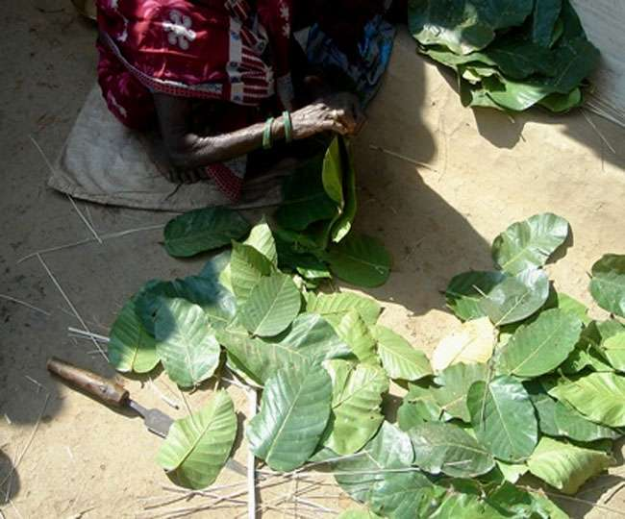
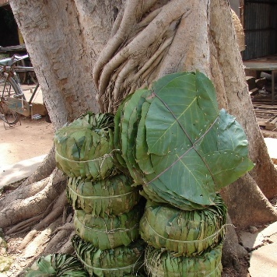
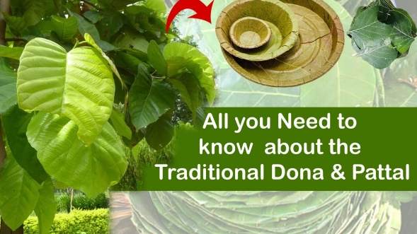
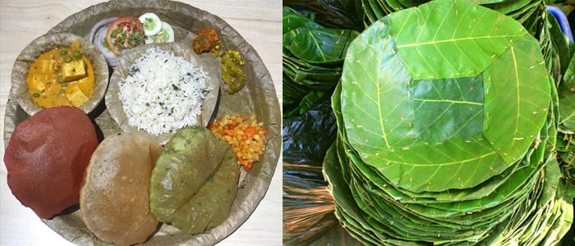
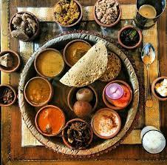
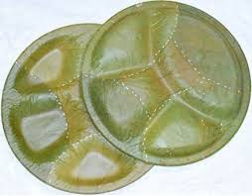
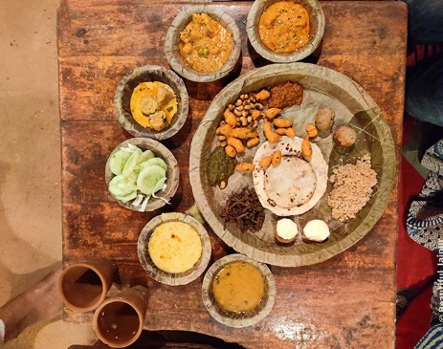
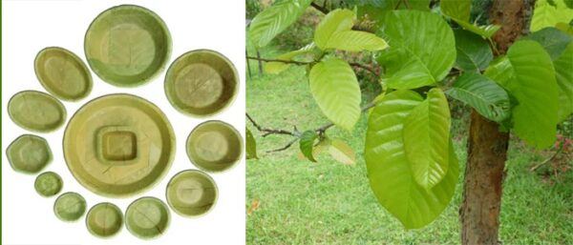
And Leaf Dona-Pattal
Dona Pattal has quickly become one of the leading suppliers of eco-friendly paper plates and cups in India. The company uses only recycled paper and non-toxic inks, which makes their products safe for the environment. Dona Pattal also participates in various environmental initiatives and is committed to reducing its carbon footprint. The company has an impressive client list that includes large corporations, small businesses, restaurants, and hotels. Dona Pattal has also become a popular choice for events, parties, and weddings. The company offers custom printing services to help clients make their events more special. Dona Pattal is committed to providing quality products and excellent customer service.

Slide 8
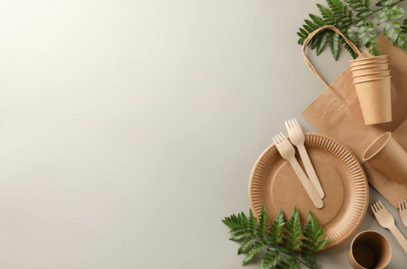
Table Of Contents
About Paper Cutlery Business
Resources Required to Start A Paper Plate Business
How to Select Paper plate Making Machine
Manufacturing plan for paper plates
Marketing and Selling of Paper plates
Paper Plate Profit Margin Estimation
Costing details as per demand
Manpower requirements
Detail Project report by Charter Accountant

Slide 9
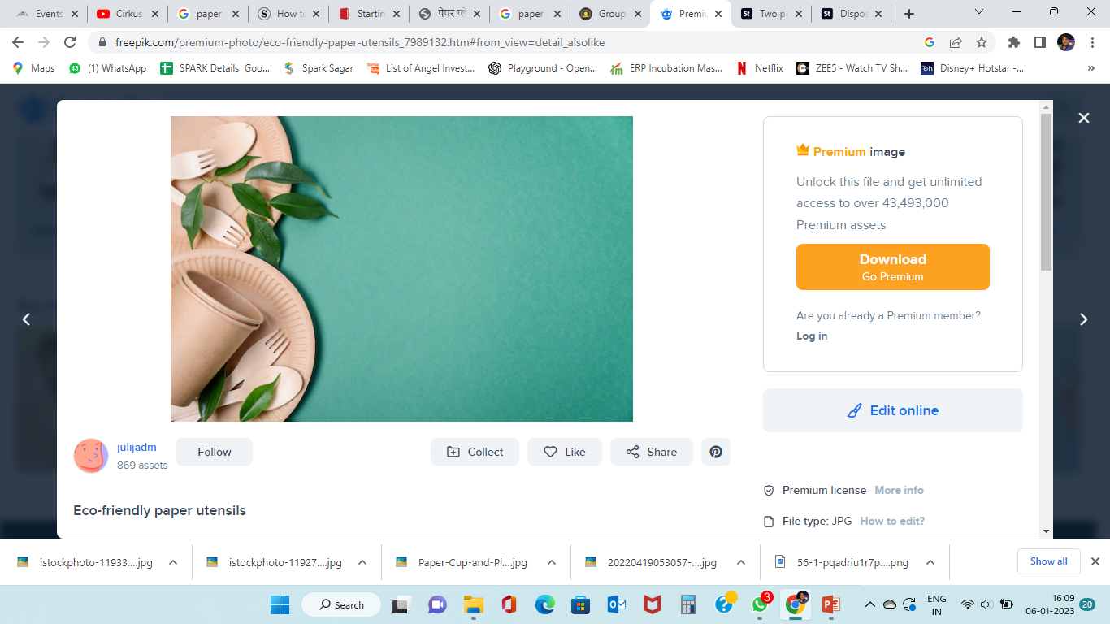
About Paper Cutlery Business
Paper plates, Bowl and cups are a great way to provide customers with convenient and affordable food-service solutions.
A paper plate business involves manufacturing plates that were made out of paper for serving food. They were considered an economical alternative to plastic plates.
With the ban of single usage plastic by several states as well as in Indian Railways. The demand for eco-friendly products such as paper plates has suddenly increased in India.

Slide 10
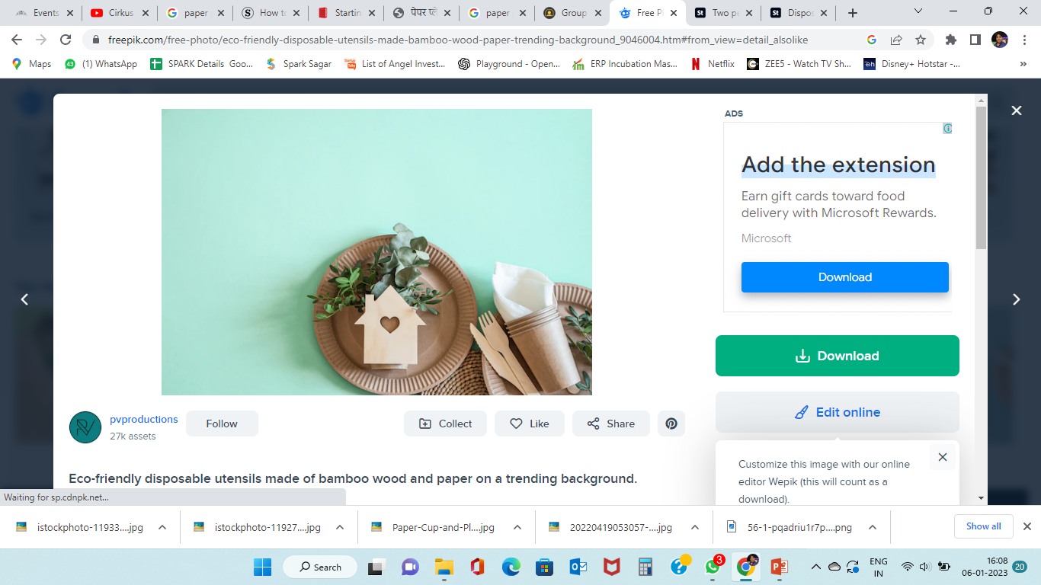
Resources Required to Start A Paper Plate Business
Land or Building for Rent
Electricity Supply
Raw Material
Paper Plate Machine
Workers

Slide 11
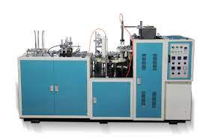
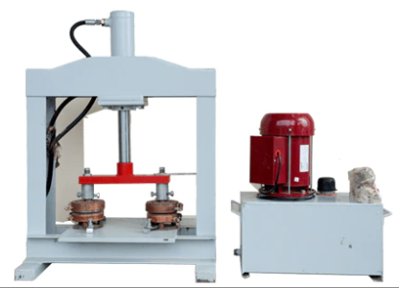
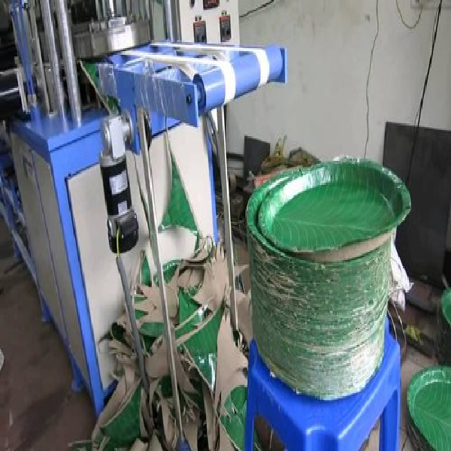
About Paper plate Making Machine
Price
Single Die Vs Double Die Vs Multiple Die
Automatic and Semi-automatic machine
Production capacity
Paper Plate Machine with Buy Back Agreement.

Slide 12
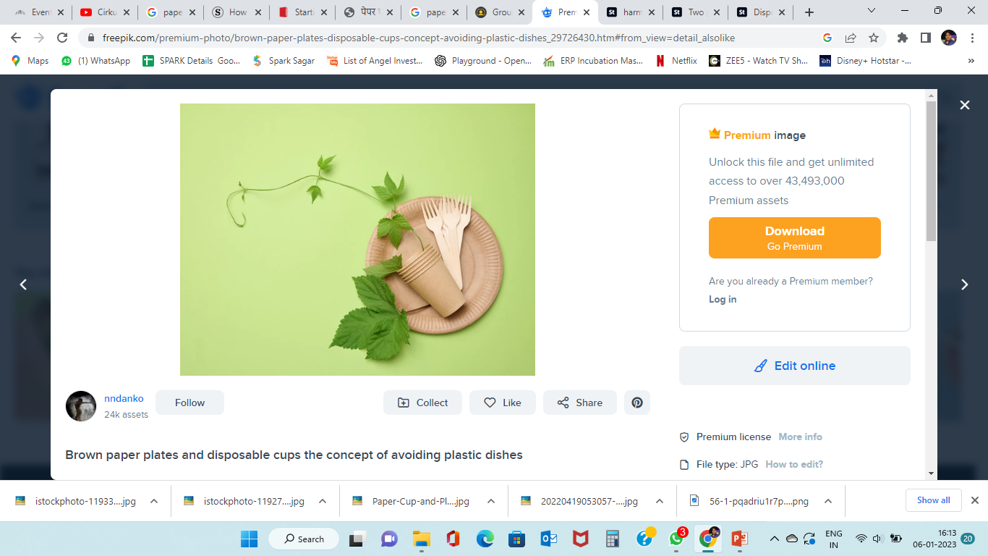
Manufacturing plan for paper plates
Market Demand
Budget
Production capacity
Types of Paper plates

Slide 13
Marketing and Selling of Paper plates
Once we have finished manufacturing of paper plates you have to sell them in the market. Paper plates have huge demand almost all over India. So, don’t have to worry about market.
However, keep in mind, selling paper plates is quite a challenging task.
Because there are already several people who do this type of business and they sell at a very low-profit margin and have a large network in the market.
But we do several things to grow your business such as
Selling your paper plates at a reasonable price than your competitors.
Get in touch with new shop keepers.
Provide free samples and ask the buyers to try them for a few days.
Build connections with small catering businesses
We Use WhatsApp to take orders. This is the simple and fastest way you can contact easily.
In some gated community apartments, you will mostly have some shops located. Approach the president or respective head of the apartment and tell them about your service. So, when there is a function or party going on in their community they will contact you
Get in touch with function hall owners and give your visiting card so that in future purposes if they require a bulk order for a function or marriage or any such occasion they may contact you.

Slide 14
Details and Breakdown of estimation
Details | Values and Amount
Type of paper plate material | 10 inches 150 GSM
Total no of plates produced per hour | 1500 (5 hours/Day)
Production capacity per year | 2,250,000 (for 300 working day)
Considering 80% as capacity utilization | 18,00,000
Average price for making and selling each plate | 1.30 INR (18,00,000 x 1.30)
Total price of the plates produced per year | 2,340,000 Lakhs INR

Slide 15
EXPENSES
Cost of raw materials | 100,000 Lakhs INR (approx.)
Transportation costs | 125,000 INR
Electricity | 130,000 INR
Land and Building advance amount | 30,000
Machinery cost | 300,000
Wages ( 2 workers) | 170,000
Building rent | 150,000
Repair and maintenance costs | 10,000
Marketing | 100,000
Other miscellaneous costs | 50,000
Depreciation 15% | 1,77,000
Total expenses | 1,342,000
Approx. Loan interest | 175,000
Expenses – Total value of plates | 1,517,000 – 2,340,000
Approx. profit amount per year | 823,000 INR

Slide 16
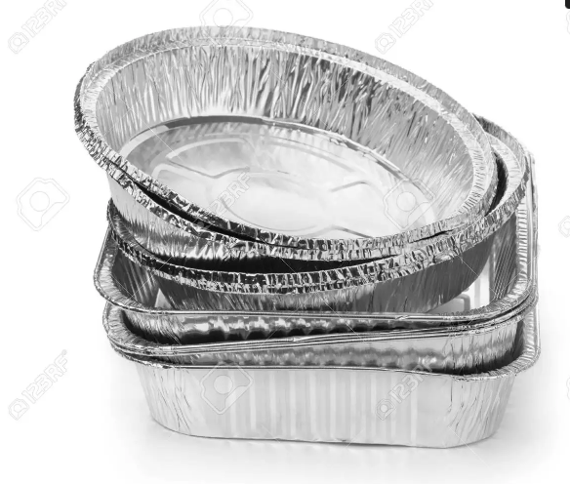
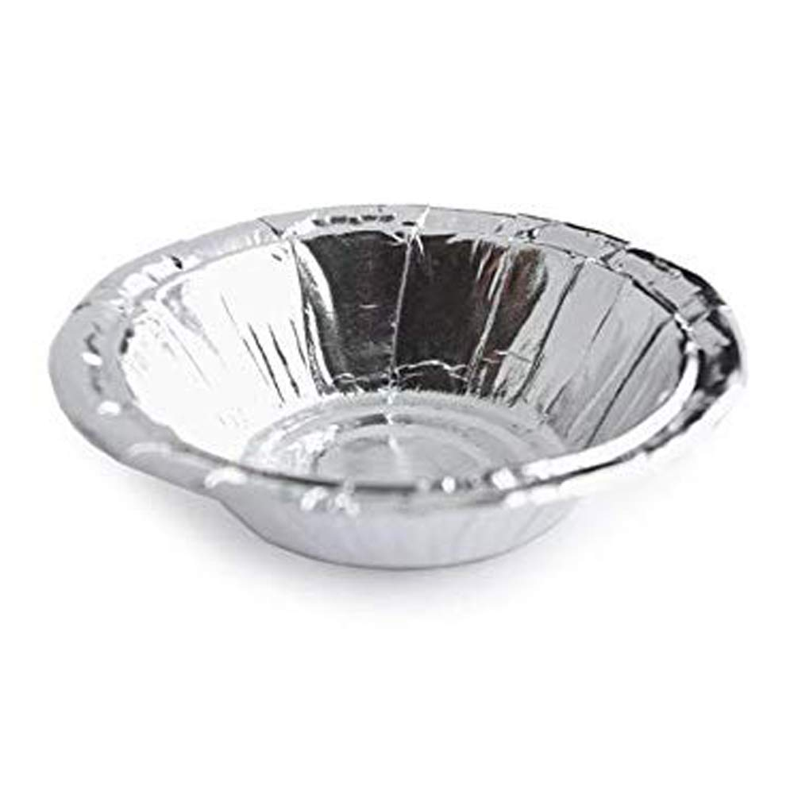
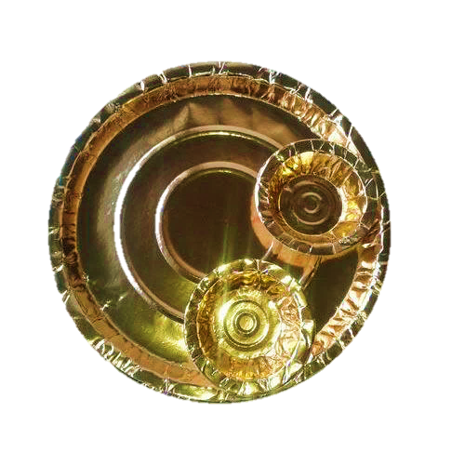
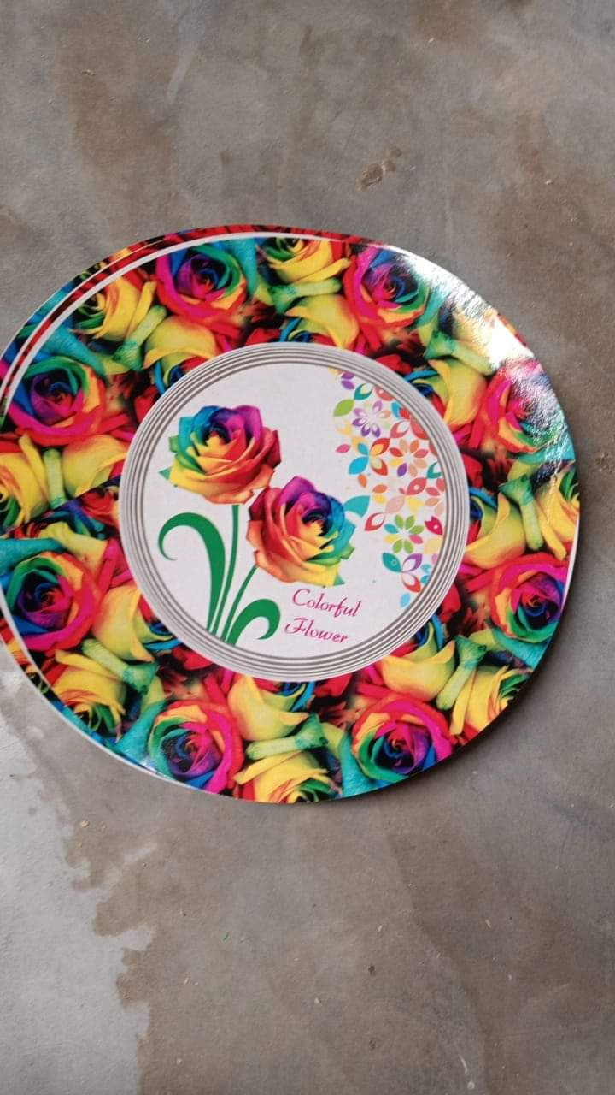
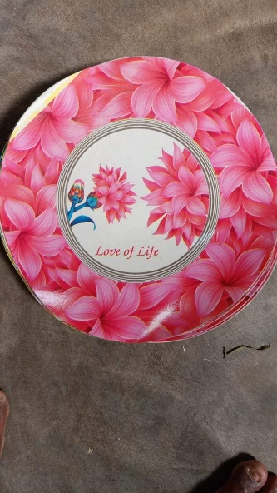
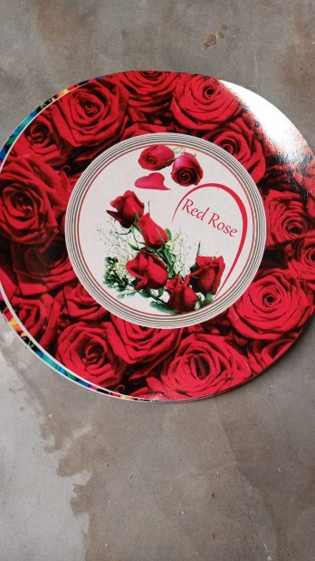
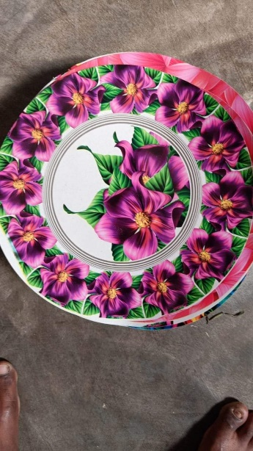
High Demand Running Products

Slide 17
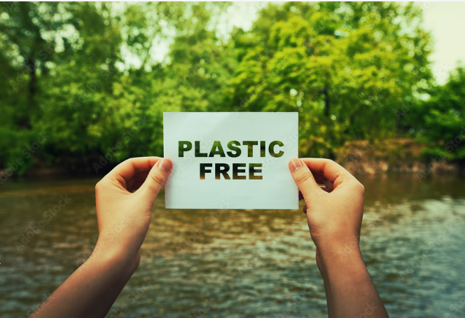
Thank you

